Slide 1
Study Series: The Word of God

Slide 2
Quiz #2: Seeking God
THE BASIC
1. Write out all 5 Scriptures from the Seeking God Study?
10 point for each scripture
Total 50 points
2. Write out one point from Matthew 7:7.13-14.
Total 30 points
3. Fill in the blanks below:
4 points for each blank
Total 20 Points
BIBLE TALK LEADERS
1. Write out all 5 Scriptures from the Seeking God Study?
10 point for each scripture
Total 50 points
2. Write out two points from
Luke 13:22-30 and two purposeful questions.
10 points for each point
5 Point for each question
Total 30 points
3. Fill in the blanks below:
4 points for each blank
Total 20 Points
Bonus Points:
10 points: Bible study/Follow up study
2 points: Every time you open the bible with someone
2 points: Every bonus passage
1 point for every person you share with
“ But seek _____ his kingdom and his _______, and all these things will be ______ to you as well. Therefore do not ______ about tomorrow, for tomorrow will worry about itself. Each day has _______ trouble of its own.”

Slide 3
Quiz #2: Seeking God
Bonus Points:
10 points: Bible study/Follow up study
2 points: Every time you open the bible with someone
2 points: Every bonus passage
1 point for every person you share with
QUIZ ANSWERS
Seeking God Study
Matthew 7:7 & 7:13-14
Luke 13:22-30
Matthew 6:25-34
Matthew 13:44-46
Acts 8:26-40
----------------------------------------------------------------------------------------------------------------
MATTHEW 7:7.13-14- ONE POINT
( Must a point that comes directly from the scripture)
† Promise: All who seek God will find him
† Warning: Only a few will find
------------------------------------------------------------
Memory Verse answers below:
First, righteousness, given, worry, enough
Luke 13:22-30
TWO POINTS
† Those who simply ‘try’ will be caught off guard by their rejection from the kingdom of God.
† Those who make every effort (agonize, struggle) will enter the Kingdom of God
TWO PURPOSEFUL QUESTIONS
† What does it look like to agonize to enter the kingdom of God vs. someone who is trying?
† Do you feel that you are making every effort to enter into God’s Kingdom?
† Are there areas of your life you need help changing so that you can make every effort?
“ But seek first his kingdom and his righteousness, and all these things will be given to you as well. Therefore do not worry about tomorrow, for tomorrow will worry about itself. Each day has enough trouble of its own.”

Slide 4
The Great Commission
“Therefore go and make disciples of all nations, baptizing them in the name of the Father and of the Son and of the Holy Spirit, and teaching them to obey everything I have commanded you. And I am with you always to the very end of the age.”
- Jesus Christ
Notes:
Purpose of doing the study series

Slide 5
The Word Study
What is the Aim of this Study?
Faith comes from hearing the message, and the message is heard through the word of Christ (Romans 10:17).
To help a seeker build faith in Jesus
One must accept the bible as the one true standard
(vs. feelings, experiences, peers’ opinions, or family traditions) by which to live life if one is to know true salvation from Jesus.

Slide 6
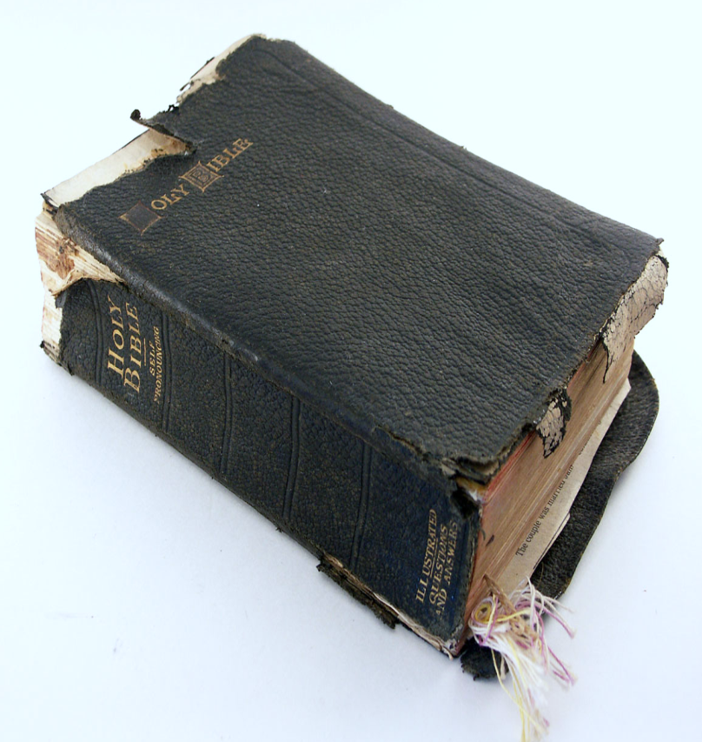
The Word Study
2 Timothy 3:16-17
Hebrews 4:12-13
1 Timothy 4:16
John 8:31-32
John 12:47-49
Acts 17:10-12

Slide 7
2 Timothy 3:16-17
The Word Study
“ All Scripture is God-breathed and is useful for teaching, rebuking, correcting and training in righteousness, so that the man of God may be thoroughly equipped for every good work.”

Slide 8
The Word Study
THE POINT OF THE PASSAGE
♦ The bible is highly useful; use it to train in righteousness.
♦ The bible thoroughly equips us; thus, it is all we need to seek a righteous life filled with every good work.

Slide 9
The Word Study
The Purposeful Question
Do you believe that the bible is God’s word?
What does it mean for the word to train you?
How would your life look like if you allowed the bible to train you?

Slide 10
1 Timothy 4:16
Memory Scripture
“Watch your life and doctrine closely. Persevere in them, because if you do, you will save both yourself and your hearers.”

Slide 11
Hebrews 4:12-13
The Word Study
“ For the word of God is living and active. Sharper than any double-edged sword, it penetrates even to dividing soul and spirit, joints and marrow; it judges the thoughts and attitudes of the heart. Nothing in all creation is hidden from God’s sight. Everything is uncovered and laid bare before the eyes of him to whom we must give account.”

Slide 12
The Word Study
THE POINT OF THE PASSAGE
♦ The word of God will always apply to our life because it deals with our hearts; not culture
♦ The word has penetrating and exposing power
♦ We will give a full accounting to God. No hiding.

Slide 13
The Word Study
The Purposeful Question
What were the consequences when God’s people refuse to listen to his voice?
Why is it so important to apply the Word to our life now?
Are there areas of your life that you are afraid to let God’s word penetrate?

Slide 14
1 Timothy 4:16
Memory Scripture
“Watch your life and doctrine closely. Persevere in them, because if you do, you will save both yourself and your hearers.”

Slide 15
1 Timothy 4:16
The Word Study
“Be diligent in these matters; give yourself wholly to them, so that everyone may see your progress. Watch your life and doctrine closely. Persevere in them, because if you do, you will save both yourself and your hearers.”

Slide 16
The Word Study
THE POINT OF THE PASSAGE
Give yourself wholly to following God’s word and it will change you
A continued changed life will also change those they are around

Slide 17
The Word Study
The Purposeful Question
What does a person’s life look like who gives themselves wholly to following God’s word?
What is the result of neglecting either life or doctrine?
How would your life and those around you change if you decide to wholeheartedly obey God’s word?

Slide 18
1 Timothy 4:16
Memory Scripture
“Watch your life and doctrine closely. Persevere in them, because if you do, you will save both yourself and your hearers.”

Slide 19
John 8:31-32
The Word Study
“To the Jews who had believed him, Jesus said, “If you hold to my teaching, you are really my disciples. Then you will know the truth, and the truth will set you free.”

Slide 20
The Word Study
THE POINT OF THE PASSAGE
♦ Intellectual belief is not enough!
♦ Everyone must hold on to and follow the teachings of Jesus to be a true a disciple
♦ Sincerity does not equal truth.

Slide 21
The Word Study
The Purposeful Question
For these Jews, why was just believing in Jesus not sufficient?
How can one know if they are true followers of Jesus?
Are there areas in your life that you would like to be set free?

Slide 22
John 12:47-49
The Word Study
“As for the person who hears my words but does not keep them, I do not judge him. For I did not come to judge the world, but to save it. There is a judge for the one who rejects me and does not accept my words; that very word which I spoke will condemn him at the last day. For I did not speak of my own accord, but the Father who sent me commanded me what to say and how to say it.”

Slide 23
The Word Study
THE POINT OF THE PASSAGE
♦ Jesus purpose in coming was to save our lives
♦ Rejecting the Word is equated with rejection of Jesus and his salvation.
♦ The Word will judge us on the last day

Slide 24
The Word Study
The Purposeful Question
Why would the people of Jesus’ day not accept his word?
What role will the bible play in our eternity?
Which words of Jesus do you find it easy to accept? Reject?

Slide 25
Acts 17:10-11
The Word Study
“As soon as it was night, the brothers sent Paul and Silas away to Berea. On arriving there, they went to the Jewish synagogue. Now the Bereans were of more noble character than the Thessalonians, for they received the message with great eagerness and examined the Scriptures every day to see if what Paul said was true. “

Slide 26
The Word Study
THE POINT OF THE PASSAGE
We must strive to imitate the character of the Berean’ believers
Read and study the bible every day!

Slide 27
The Word Study
The Purposeful Question
What character traits did the Bereans have over the Thessalonians?
How are you going to imitate the Bereans in your walk with God?
Why do you think it is important to examine the scriptures?

Slide 28
The Word Study
The Purposeful Question

Slide 29
End the Study
Prayer
Set Up Next Study
Give scriptures for the next study
Discipleship
Acts 11:25-26
Luke 9:23-27
Luke 9:57-62
Mark 1:16-20
Matthew 28:18-20
Matthew 22:34-40

Slide 30
Additional Scriptures
John 7:17 Matthew 13:1-23 2 Peter 3:16 Mark 7:6-9 John 8:31-32 James 1:22-25 2 Timothy 2:15 1 Thessalonians 2:13 Psalms 119:60 2 Timothy 4:2-3
Ezekiel 33:30-33 Jude 3 1 Corinthians 4:4 2 Peter 1:19-21 Proverbs 3:5 Proverbs 14:12 Proverbs 16:2 Proverbs 28:26 Proverbs 30:5-6 Proverbs 28:9

Slide 31
Quiz Next Week
There will be weekly quizzes each week that will include the following:
(1) knowing the scriptures in each study,
(2) the memory verse and
(3) One points for each scripture.
For Bible Talk Leaders or if you have done guard the gospel within the last 5 years.
(4) Know 2 points from each scripture plus 2 purposeful questions

